Slide 1
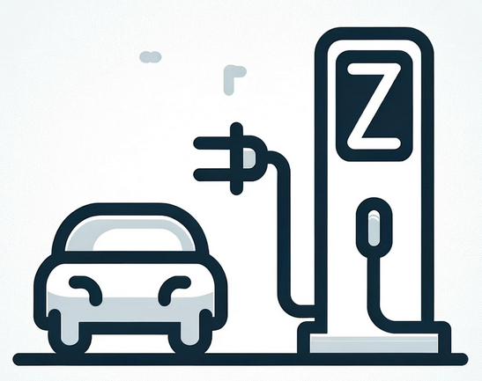



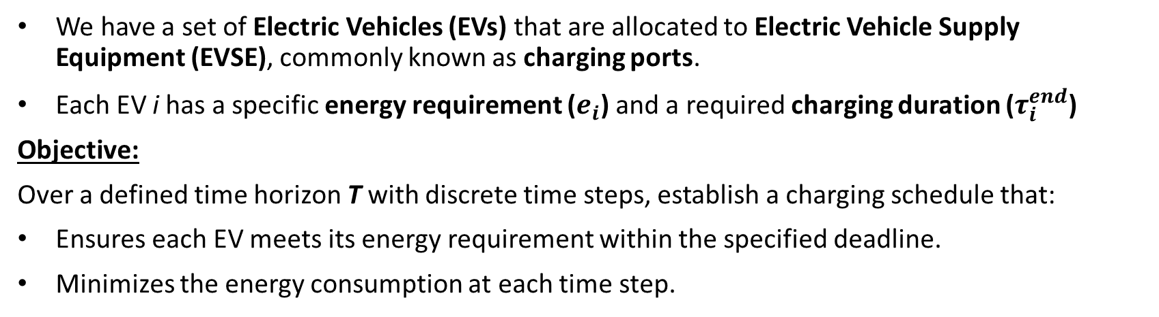












Problem Statement
We have a set of Electric Vehicles (EVs) that are allocated to Electric Vehicle Supply Equipment (EVSE), commonly known as charging ports.
Each EV i has a specific energy requirement ($e_{i}$) and a required charging duration ($τ_{i}^{end}$)
Objective:
Over a defined time horizon T with discrete time steps, establish a charging schedule that:
Ensures each EV meets its energy requirement within the specified deadline.
Minimizes the energy consumption at each time step.
$$t_{0}$$
$$t_{1}$$
$$t_{2}$$
$$t_{3}$$
$$t_{4}$$
$$t_{5}$$
$$t_{6}$$
$$t_{7}$$
$$T$$
$$e_{1}$$
$$τ_{1}^{end}$$
$$e_{2}$$
$$τ_{2}^{end}$$
$$e_{3}$$
$$τ_{3}^{end}$$
Notes:
This is an online challenge proposed by the university of alberta, Canada, where they try to solve the city’s electric vehicle energy problem and they are interested in exploring possible quantum method to approach the problem. The problem statement is the following: suppose you have a a set of EV and a set of charging ports and each EV has its own energy requirmenet an its own charging duration requirements which is basically a deadline to charge.
The goal is to find an charging schedule over a time horizon of disrete timesteps, that satisfy the deamands of every EV while also minimize the tota energy consumption in each timestep

Slide 2

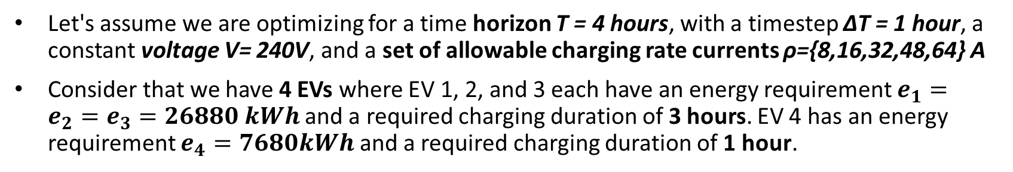

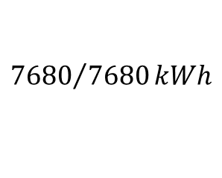

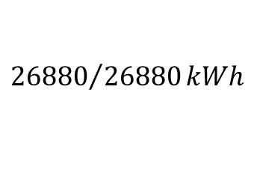

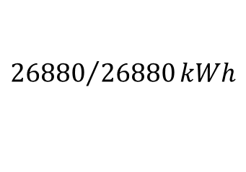
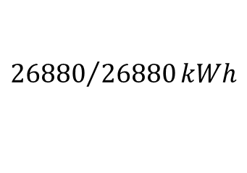
Toy Example
Let's assume we are optimizing for a time horizon T = 4 hours, with a timestep ΔT = 1 hour, a constant voltage V= 240V, and a set of allowable charging rate currents ρ={8,16,32,48,64} A
Consider that we have 4 EVs where EV 1, 2, and 3 each have an energy requirement $e_{1}=e_{2}=e_{3}=26880 kWh$and a required charging duration of 3 hours. EV 4 has an energy requirement $e_{4}=7680kWh$ and a required charging duration of 1 hour.
$$t_{0}$$
$$t_{1}$$
$$t_{2}$$
$$t_{3}$$
T
16 A | 48 A | 48 A | 0
32A | 48A | 32A | 0
32A | 32A | 48A | 0
32A | 0 | 0 | 0
$${26880}/{26880}kWh$$
$${26880}/{26880}kWh$$
$${26880}/{26880}kWh$$
$${7680}/{7680}kWh$$
Notes:
Lets see a simple example. Here we have a horizon of 4 hours with 1 hour timestep and a constant voltage and we are allowed to choose the charging current from this discrete set. Suppose we have 4 Evs where the 3 of those require to receive this amount energy within 3 hours and the last one require to receive this amount of energy in only 1 hour.
A possible solution for the problem would be the this schedule right here. As you can see we optimize over the current rates and this schedule manages to not only satisfy the demands of every but also manages to not overload the network. We try not use 48A amperes all at once, the idea is to somehow distribute them thought out the hole time span we have.

Slide 3
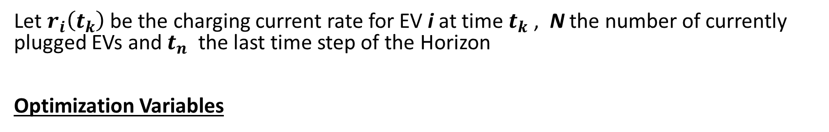
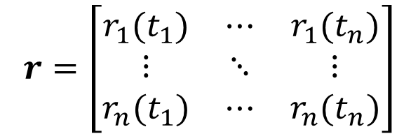
QUBO Formulation of the Problem
Let $r_{i}\left(t_{k}\right)$ be the charging current rate for EV i at time $t_{k}$ , N the number of currently plugged EVs and $t_{n}$ the last time step of the Horizon
Optimization Variables
$$r=\left[\begin{matrix}r_{1}(t_{1}) & ⋯ & r_{1}(t_{n}) \\ ⋮ & ⋱ & ⋮ \\ r_{n}(t_{1}) & ⋯ & r_{n}(t_{n})\end{matrix}\right]$$
Notes:
So how we formulate the problem into QUBO? First we have to define the optimization variables . We define r I tk to be the charging current of the EV I at time tk , N capital be the number of active Evs and tn be the lasta timestep of the horizon.
Our optimization variable woulb be the this matrix right here

Slide 4
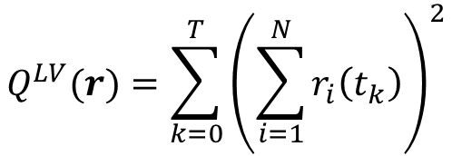
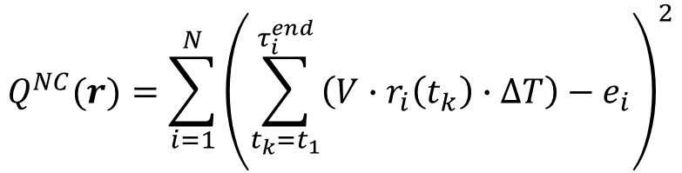
QUBO Formulation of the Problem
Let $r_{i}\left(t_{k}\right)$ be the charging current rate for EV i at time $t_{k}$ , N the number of currently plugged EVs and $t_{n}$ the last time step of the Horizon
Optimization Variables
$$r=\left[\begin{matrix}r_{1}(t_{1}) & ⋯ & r_{1}(t_{n}) \\ ⋮ & ⋱ & ⋮ \\ r_{n}(t_{1}) & ⋯ & r_{n}(t_{n})\end{matrix}\right]$$
Cost Function
Non – Completion Penalty
Load Variation
$$Q^{NC}(r)=\sum_{i=1}^{N}{{\left(\sum_{t_{k}=t_{1}}^{τ_{i}^{end}}{\left(V∙r_{i}\left(t_{k}\right)∙ΔT\right)}−e_{i}\right)}^{2}}$$
$$Q^{LV}(r)=\sum_{k=0}^{T}{{\left(\sum_{i=1}^{N}{r_{i}\left(t_{k}\right)}\right)}^{2}}$$
Notes:
And the cost function would be the a combination of two cost function each one represents a differet aspect of the problem. The fist one is a non- completion penalty cost function. A cos tfunction that basically penalizes the uncovered demands. And the second one is a cost function that minimizes the total energy consumption in each time step.

Slide 5
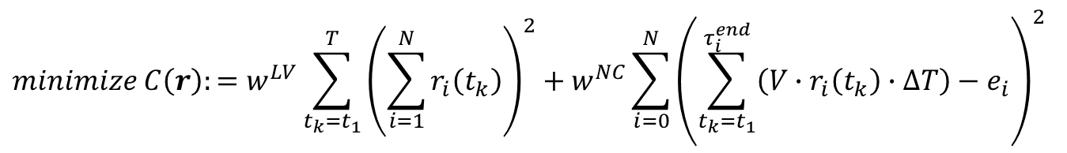
QUBO Formulation of the Problem
$$minimize C\left(r\right):=w^{LV}\sum_{t_{k}=t_{1}}^{T}{{\left(\sum_{i=1}^{N}{r_{i}\left(t_{k}\right)}\right)}^{2}+w^{NC}}\sum_{i=0}^{N}{{\left(\sum_{t_{k}=t_{1}}^{τ_{i}^{end}}{\left(V∙r_{i}\left(t_{k}\right)∙ΔT\right)}−e_{i}\right)}^{2}}$$
Notes:
So the problems cost function would be written as a weighted sum of the two cost function.

Slide 6
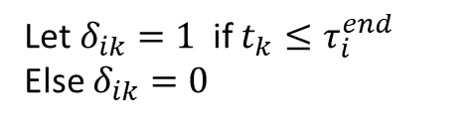
QUBO Formulation of the Problem
$$minimize C\left(r\right):=w^{LV}\sum_{t_{k}=t_{1}}^{T}{{\left(\sum_{i=1}^{N}{r_{i}\left(t_{k}\right)}\right)}^{2}+w^{NC}}\sum_{i=0}^{N}{{\left(\sum_{t_{k}=t_{1}}^{τ_{i}^{end}}{\left(V∙r_{i}\left(t_{k}\right)∙ΔT\right)}−e_{i}\right)}^{2}}$$
Let $δ_{ik}=1$if $t_{k}≤τ_{i}^{end}$
Else $δ_{ik}=0$
Notes:
We want to get rid these terms here
so we introduce the indicators delta where delta ik is 1 if the timestep tk comes before the deadline of I… and 0 otherwise

Slide 7
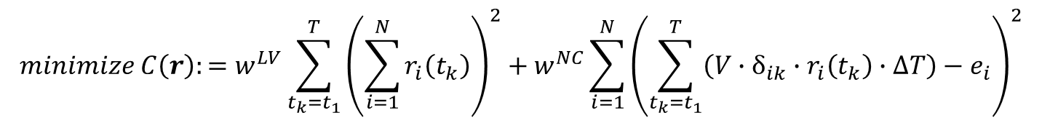
QUBO Formulation of the Problem
$$minimize C\left(r\right):=w^{LV}\sum_{t_{k}=t_{1}}^{T}{{\left(\sum_{i=1}^{N}{r_{i}\left(t_{k}\right)}\right)}^{2}+w^{NC}}\sum_{i=0}^{N}{{\left(\sum_{t_{k}=t_{1}}^{τ_{i}^{end}}{\left(V∙r_{i}\left(t_{k}\right)∙ΔT\right)}−e_{i}\right)}^{2}}$$
Let $δ_{ik}=1$if $t_{k}≤τ_{i}^{end}$
Else $δ_{ik}=0$
$$minimize C\left(r\right):=w^{LV}\sum_{t_{k}=t_{1}}^{T}{{\left(\sum_{i=1}^{N}{r_{i}\left(t_{k}\right)}\right)}^{2}+w^{NC}}\sum_{i=1}^{N}{{\left(\sum_{t_{k}=t_{1}}^{T}{\left(V∙δ_{ik}∙r_{i}\left(t_{k}\right)∙ΔT\right)}−e_{i}\right)}^{2}}$$
Notes:
So with the addition of the deltas the cost function would rewritten in a more convenient way like this

Slide 8

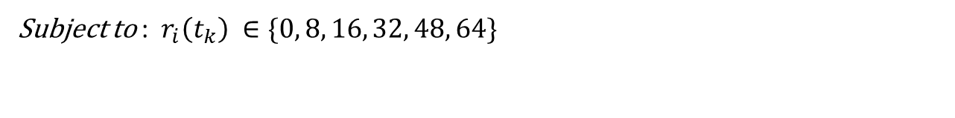
QUBO Formulation of the Problem
$$minimize C\left(r\right):=w^{LV}\sum_{t_{k}=t_{1}}^{T}{{\left(\sum_{i=1}^{N}{r_{i}\left(t_{k}\right)}\right)}^{2}+w^{NC}}\sum_{i=0}^{N}{{\left(\sum_{t_{k}=t_{1}}^{τ_{i}^{end}}{\left(V∙r_{i}\left(t_{k}\right)∙ΔT\right)}−e_{i}\right)}^{2}}$$
Let $δ_{ik}=1$if $t_{k}≤τ_{i}^{end}$
Else $δ_{ik}=0$
$$minimize C\left(r\right):=w^{LV}\sum_{t_{k}=t_{1}}^{T}{{\left(\sum_{i=1}^{N}{r_{i}\left(t_{k}\right)}\right)}^{2}+w^{NC}}\sum_{i=1}^{N}{{\left(\sum_{t_{k}=t_{1}}^{T}{\left(V∙δ_{ik}∙r_{i}\left(t_{k}\right)∙ΔT\right)}−e_{i}\right)}^{2}}$$
Subject to : $r_{i}\left(t_{k}\right) ∈\{0, 8, 16, 32, 48, 64\}$
$$\sum_{i=1}^{N}{V∙r_{i}\left(t_{k}\right)≤C ∀t_{k} }$$
Where C is the Network’s power capacity
Notes:
And on top of that we can include some constraints…
The first constraint is limiting the variables to take values from this discrete set.
And the second constraint is to set a power supply limit at any givem timestep… C here is the power capacity of the network and the cumulative power supply that is being given to the plugged in Evs.., can not that number…
So there are two thing to be done from here.. The first thing is to convert the problem into binary…
And the second thing is to incorporate the inequality constraints into the cost function.. Which is not trivial.

Slide 9
Binary Conversion
We have to find a binary encoding for the set {0, 8, 16, 32, 48, 68}
Notes:
So for the binary conversion we employ have to find a binary encoding for this

Slide 10
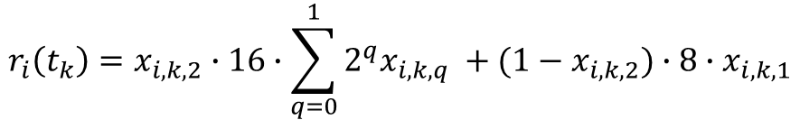
Binary Conversion
We have to find a binary encoding for the set {0, 8, 16, 32, 48, 68}
Simplest one I could think of
$$r_{i}\left(t_{k}\right)=x_{i, k,2}∙16∙\sum_{q=0}^{1}{2^{q}x_{i, k,q} }+(1−x_{i, k,2})∙8∙x_{i, k,1}$$
Notes:
I tried really hard but the simplest one I could think of is this one, which uses three qubits.

Slide 11
Binary Conversion
We have to find a binary encoding for the set {0, 8, 16, 32, 48, 68}
Increases the order of the cost function
Simplest one I could think of
$$r_{i}\left(t_{k}\right)=x_{i, k,2}∙16∙\sum_{q=0}^{1}{2^{q}x_{i, k,q} }+(1−x_{i, k,2})∙8∙x_{i, k,1}$$
Notes:
But this encoding here … violates the quadraticness of the cost function so I had to abandon it

Slide 12

Binary Conversion
We have to find a binary encoding for the set {0, 8, 16, 32, 48, 68}
Increases the order of the cost function
Simplest one I could think of
$$r_{i}\left(t_{k}\right)=x_{i, k,2}∙16∙\sum_{q=0}^{1}{2^{q}x_{i, k,q} }+(1−x_{i, k,2})∙8∙x_{i, k,1}$$
Instead, we simplify the set of allowable currents to : {0, 16, 32, 48 }
$$r_{i}\left(t_{k}\right)=16∙\sum_{q=0}^{1}{2^{q}x_{i, k,q} }$$
Notes:
And I had to simplify the set to this one in order to the standard encoding with 2 qubits

Slide 13


Incorporating Inequality Constraints
Convert Inequality Constraint to Equality Constraint
$$\sum_{i=1}^{N}{V∙r_{i}\left(t_{k}\right)≤C ∀t_{k} }$$
$$\sum_{i=1}^{N}{V∙r_{i}\left(t_{k}\right)+s_{k}=C ∀t_{k} }$$
“Slack Variables” $s_{k}$ are positive integers where $s_{k}≤C$
To encode one of them we need $\left\lceil \log_{2}C\right\rceil$ binary variables
For a n timestep Horizon we need additional n$\left\lceil \log_{2}C\right\rceil$ binary variables
Notes:
For the inequality constraints. In order to embody them into the cost function we have to convert them into equality constraint and then incorporate them using the square error method.
To convert them into equality constraint we have to introduce an additional variable to the problem sk which we call slack variable the they are a positive integer which can go up to the value of C.
So to encode them we need additional logC bits…… and for a n timestep Horizon we would need extra nlogC bits. If we want to avoid this additional complexity there is an alternative way.
We can incorporate the C into the weight f=of the load variation cost function. In way that when the decrases the weight increases. So what I am gone do is I am gone use both methods.
For the experiments that we compare the quantum algorithm with the classical ones I am gonna the slack variable method to keep the comparison fair.
But for the experiments that compares the VQE with Compressed VQE or compressed VQE for different shots etc I am gonna use the second method

Slide 14
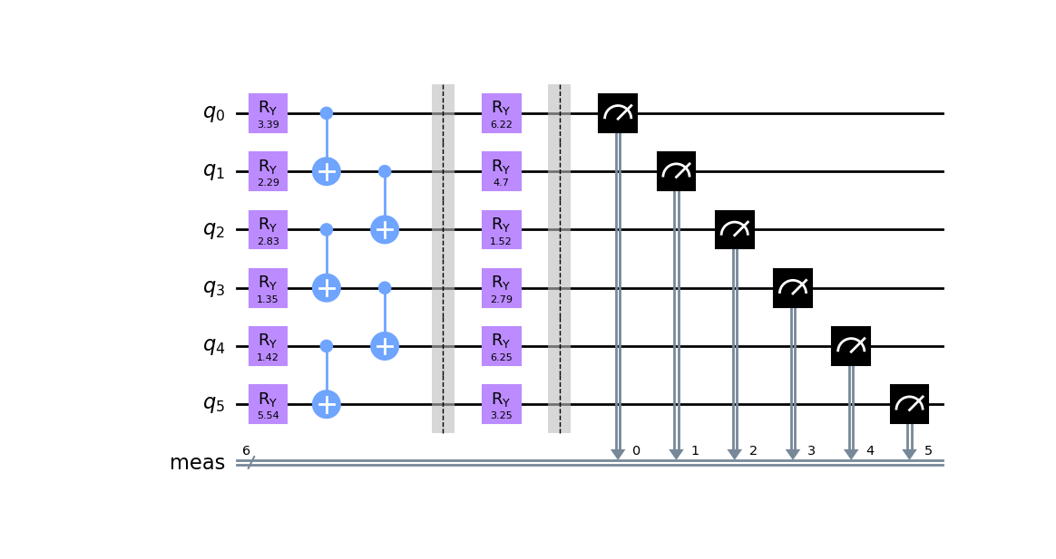
Circuit: HEA with 2 layers
Notes:
So moving on to the experimental procedure I am going to use simple quantum efficient ansatz.

Slide 15
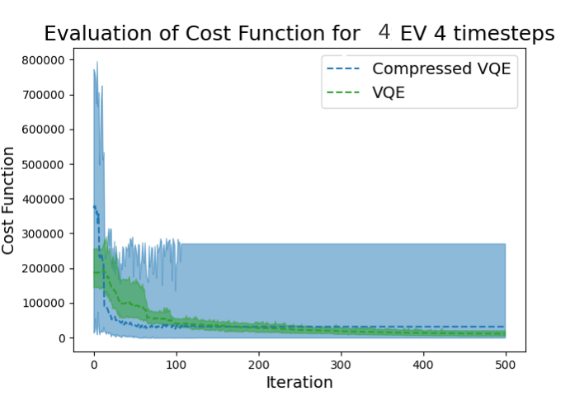
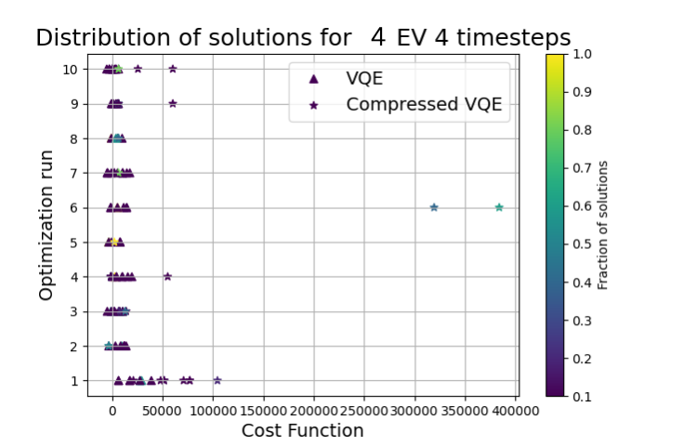
Experimental Procedure: Toy Example
For the toy example with T=4 hours , Evs = 4 and 2 layer HEA
Algorithm | #Classical Variables | #Qubits | #Shots | #parameters θ | #Ry gates | #CNOT gates | #gates | #iterations
VQE | 16 | 32 | 5000 | 64 | 64 | 31 | 95 | 400+
CompressedVQE | 16 | 6 | 10000 | 12 | 12 | 5 | 17 | 130
Notes:
And for the first experiment I will solve the toy example that I describe at the beginning. Using full encoding VQE and 2 body correlation compressed VQE. The reason behind the use of 2 body correlation is that I want to at least capture the correlation of the two qubits here

Slide 16
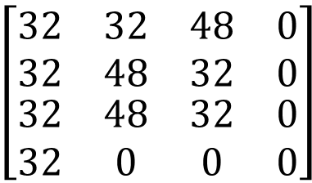
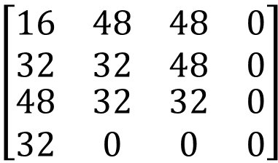
Toy Example
CompressedVQE
VQE
$$\left[\begin{matrix}\begin{matrix}32 & 32 \\ 32 & 48\end{matrix} & \begin{matrix}48 & 0 \\ 32 & 0\end{matrix} \\ \begin{matrix}32 & 48 \\ 32 & 0\end{matrix} & \begin{matrix}32 & 0 \\ 0 & 0\end{matrix}\end{matrix}\right]$$
26880/26880
26880/26880
26880/26880
7680/7680
$$\left[\begin{matrix}\begin{matrix}16 & 48 \\ 32 & 32\end{matrix} & \begin{matrix}48 & 0 \\ 48 & 0\end{matrix} \\ \begin{matrix}48 & 32 \\ 32 & 0\end{matrix} & \begin{matrix}32 & 0 \\ 0 & 0\end{matrix}\end{matrix}\right]$$
26880/26880
26880/26880
26880/26880
7680/7680
Notes:
And here are the results that both of those gave. Both are correct solutions

Slide 17
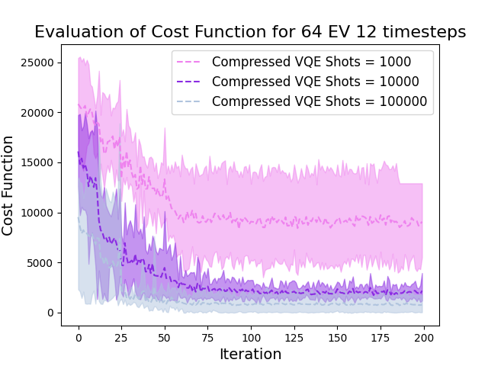
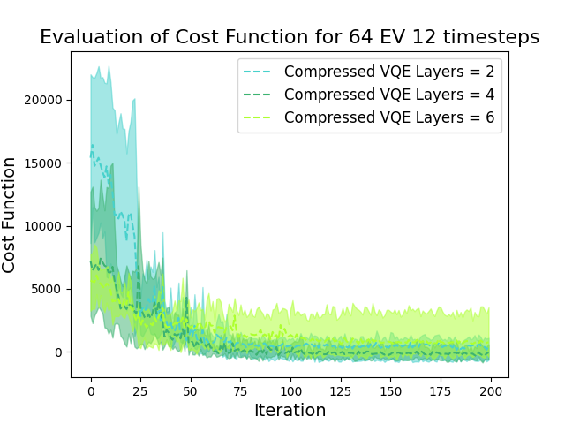
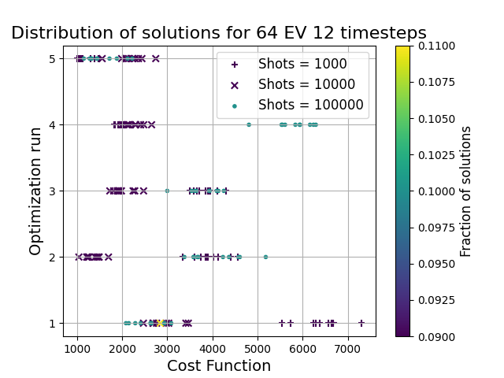
Large Scale Example
64 Evs 12 timestep Horizon $→$ 1.536 binary variables , 12 qubits
Notes:
Now I am moving to a larger scale example here we have 64 Evs 12 timestep horizon, that corresponds to

Slide 18
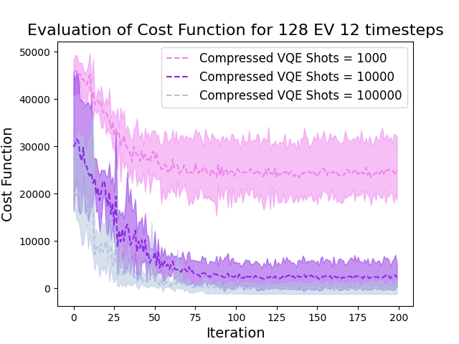
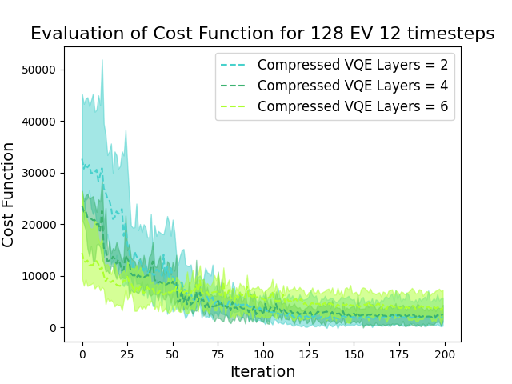
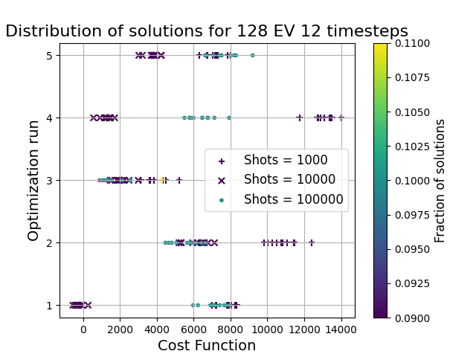
Large Scale Example
128 Evs 12 timestep Horizon $→$ 3.072 binary variables , 13 qubits
Notes:
And another larger example here

Slide 19
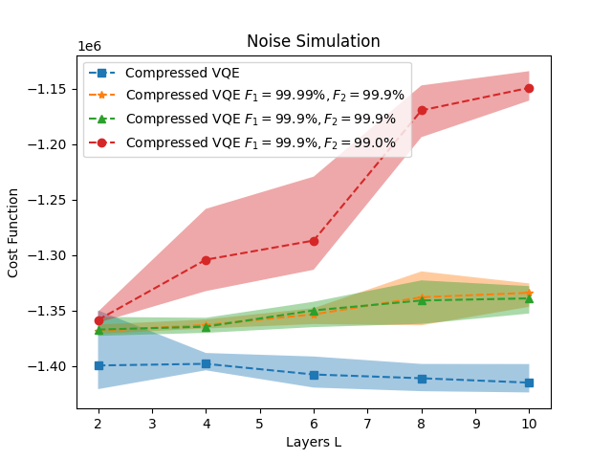
Noise Simulation
8 Evs 4 timestep Horizon $→$ 64 binary variables , 7 qubits
Notes:
And also performed a noise simulator for different kind of gate fidelities

Slide 20
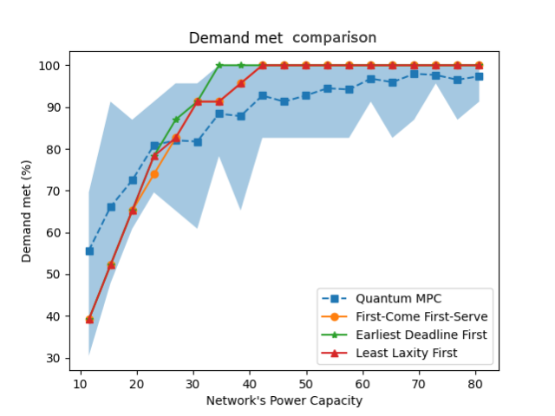
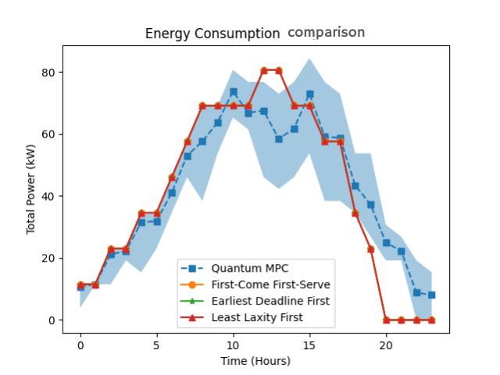
Comparison with Classical Algorithms
Simulation of 100 Evs that arrives and depart in a timespan of 24 hours
Notes:
And lastly we compare the quantum algorithm with few classical ones .

